Slide 1
Modeling Visuo-Spatial Sketchpad of Working Memory and Long-Term Memory of Human Brain Through Spiking Neural Networks (SNN)
Amod Holla (4th year BTech student, EE, IIT Delhi)
Co-supervised by:
Prof Sumeet Agarwal (EE, IIT Delhi)
Prof Debanjan Bhowmik (EE, IIT Bombay)

Slide 2
Layout of the Talk
Motivation
Training of spike-time-dependent-plasticity(STDP)-enabled SNN for handwritten digit recognition (MNIST)
Modeling the digit-learning aspect of long-term memory (LTM) through the above SNN
Modeling the network of sensory neurons, visuo-spatial sketchpad of working memory, and LTM through SNN, and demonstrating digit recollection
Future Work

Slide 3
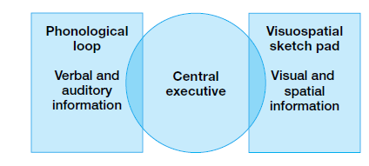
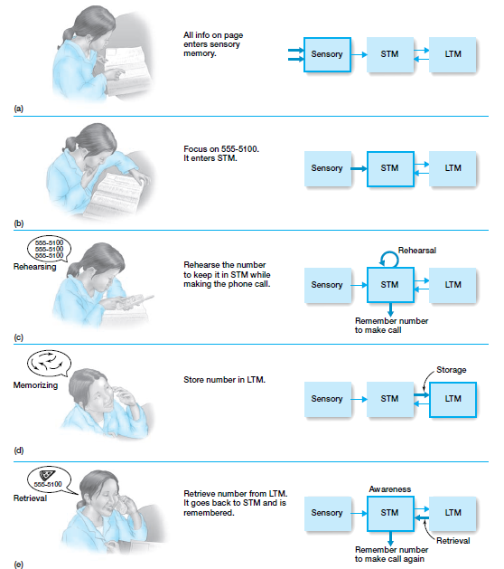
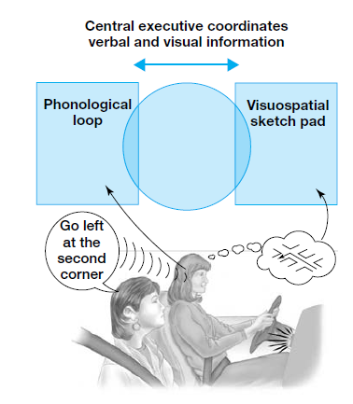
Top-Down View of Neuroscience (overlaps with Psychology)
Working memory
(modern approach
to STM) and
its components
E. B. Goldstein,
Cognitive Psychology,
Wordsworth Cengage
Learning (2005)
Interaction between sensory memory, short-term
memory (STM), and long-term memory (LTM)

Slide 4
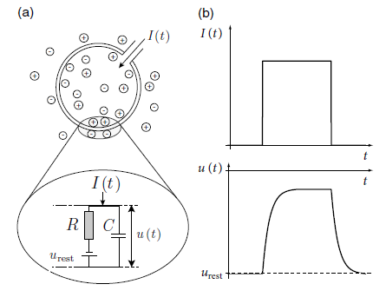
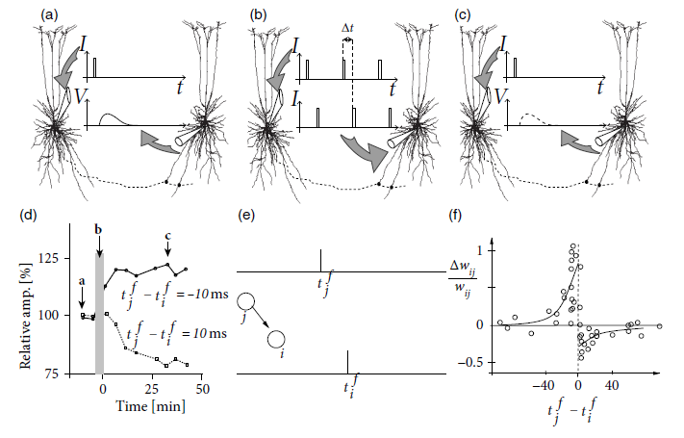
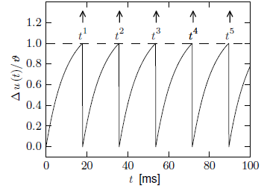
Bottom-Up View of Neuroscience: Biologically Motivated Component Models of SNN
Spike Time Dependent Plasticity (STDP) property of a synapse
Leaky Integrate Fire (LIF) model of a neuron
W. Gernstner et al, Neuronal Dynamics,
Cambridge University Press (2014)

Slide 5
Goals of This Project
Explain top-down psychological phenomena like working memory and long-term memory interaction using bottom-up neuroscience models like SNN
Since working memory encompasses a lot of functionalities, we focus on only the visuo-spatial sketchpad here.
We model a simpler version of this particular aspect of the visuo-spatial sketchpad:
“Brooks showed that performance interacted with modality of presentation, with auditory presentation favouring the visuospatial code, and reading the non-spatial sequence. He interpreted this result in terms of interference between the mode of presentation and the mode of storage; reading the visually presented sentences interfered with the visuospatial matrix code and vice versa. My own involvement in this are was influenced by the personal experience of listening to the UCLA-Stanford American football game while driving
along a freeway. I had a very good image of the game, but noticed that I was
weaving from lane to lane, and rapidly switched to music.”
(from Chapter 5 of Working Memory, Thought, and Action by Alan Baddeley, OUP (1997)

Slide 6
Layout of the Talk
Motivation
Training of spike-time-dependent-plasticity(STDP)-enabled SNN for handwritten digit recognition (MNIST), and modeling the digit-learning aspect of long-term memory (LTM) through this SNN.
Modeling the network of sensory neurons, visuo-spatial sketchpad of working memory, and LTM through SNN, and demonstrating digit recollection
Future Work

Slide 7
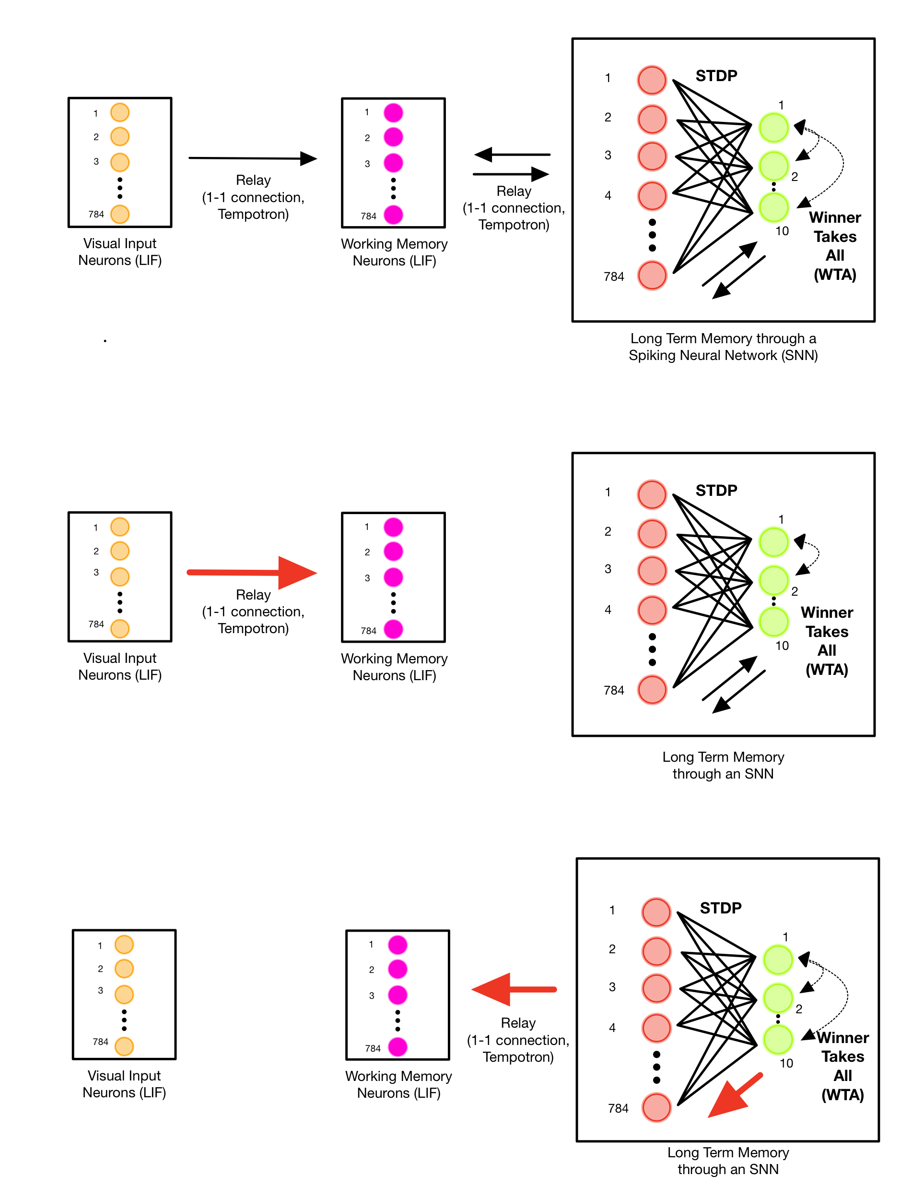
Complete Visual Memory System

Slide 8
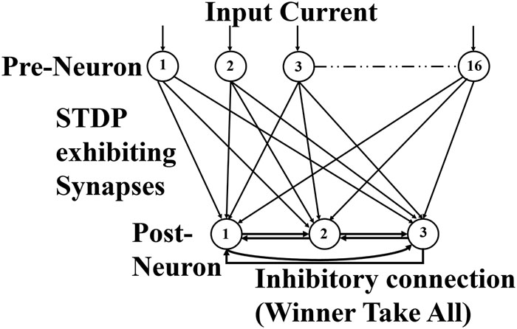
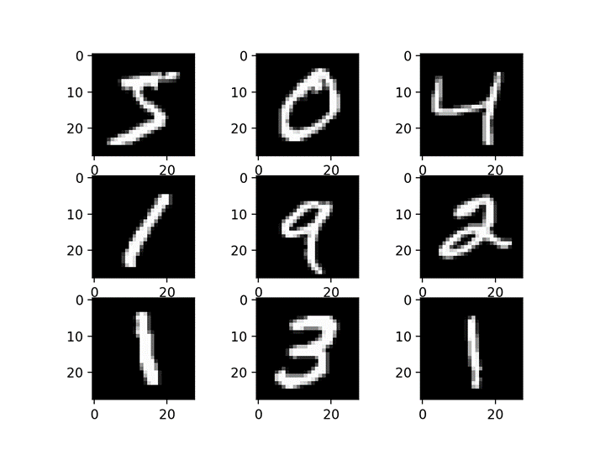
STDP-Enabled SNN to mimic long-term memory for digit learning
Sample MNIST Images
Extended to 10 post
Neurons for MNIST handwritten digits
U. Sahu, K. Goyal, A. Pandey, and D. Bhowmik, AIP Advances 9, 125339 (2019)

Slide 9
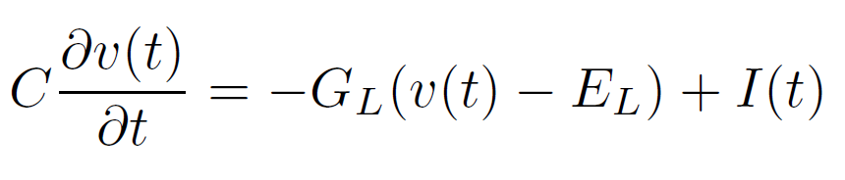
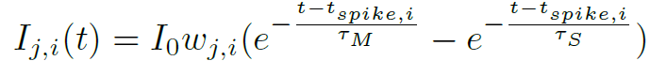
Details of the SNN Components and Their Implementation
Dynamic equation of an LIF neuron
Tempotron model of synapse for forward propagation of spikes:
Where, I(t) is the input to the neuron and v(t) is the membrane potential
Where, Ij,i(t) is the current injected into neuron ‘j’ when neuron ‘i’ fires. (Double exponential function of time)
U. Sahu, K. Goyal, A. Pandey, and D. Bhowmik, AIP Advances 9, 125339 (2019)

Slide 10
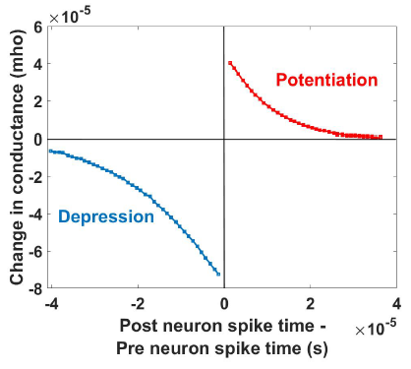
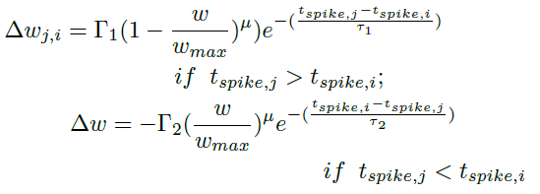
Details of the SNN Components and Their Implementation
STDP property of synapse for learning:
The neurons are simulated in Python using the Brian2 platform, with the desired equations for STDP, Tempotron, homeostasis, and LIF implemented. Brian2 requires behavioral equations for our neuron population; the above equations are utilized for this.
U. Sahu, K. Goyal, A. Pandey, and D. Bhowmik, AIP Advances 9, 125339 (2019)

Slide 11
Training and Recapitulation Details
Training is done in the partially supervised mode for 1 epoch with 784 input neurons and 10 output neurons.
After training, learning is turned off and each output neuron is fired in sequence. The spike count of each input neuron is recorded and plotted for exposure to 1, 10 and 100 samples per class. Plotting is done by graphing the spike count for each of the 784 neurons in a 28x28 grid.

Slide 12
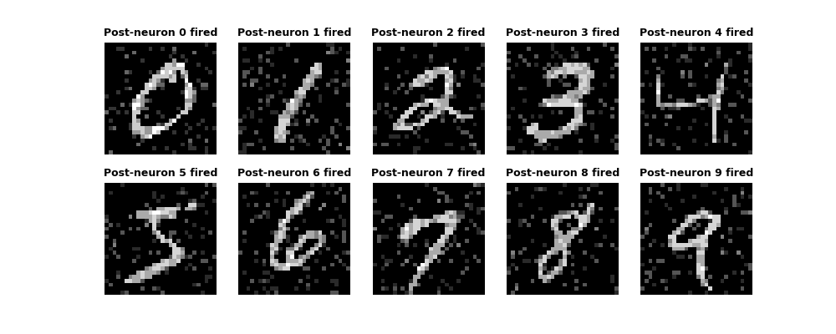
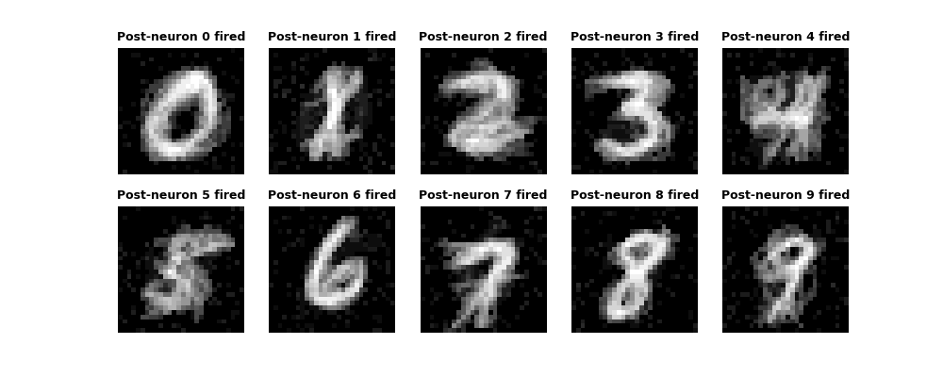
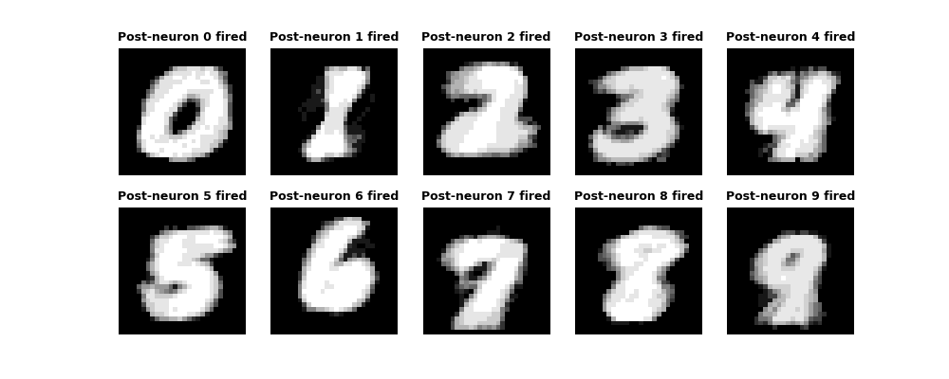
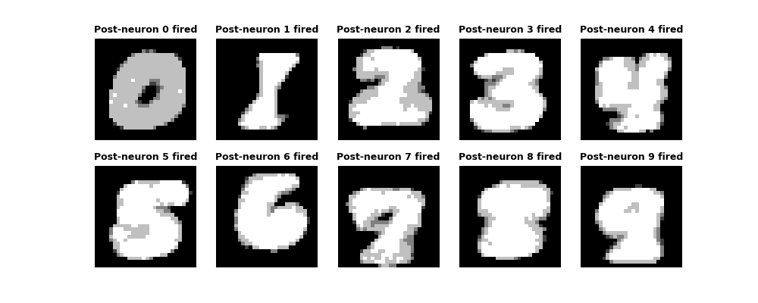
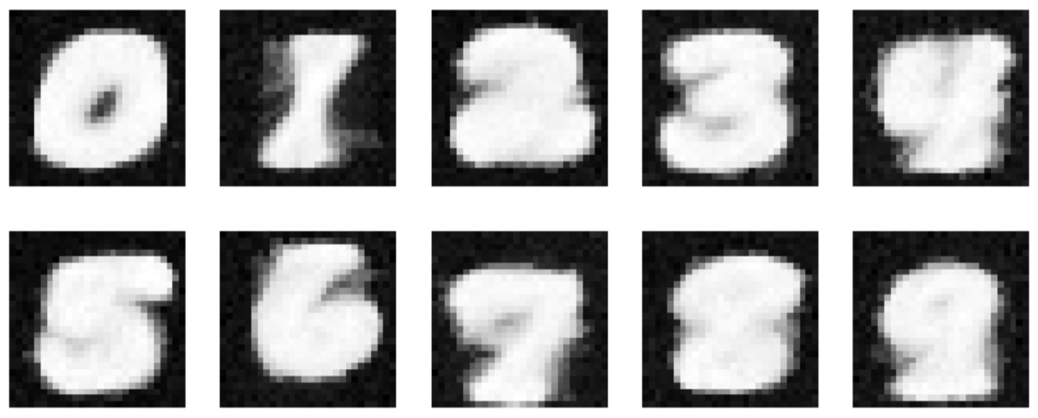
Recapitulation results for exposure to different number of samples
All cases were tested on the same 10 samples per class (unbiased samples)
1 sample/class
Train Accuracy: 90%
Test Accuracy: 25%
10 samples/class
Train Accuracy: 61%
Test Accuracy: 38%
100 samples/class
Train Accuracy: 81.4%
Test Accuracy: 75%
500 samples/class
Train Accuracy: 71.14%
Test Accuracy: 69%
1000 samples/class
Train Accuracy: 68.3%
Test Accuracy: 66%

Slide 13
Recapitulation results for exposure to different number of samples
All cases were tested on the same 10 samples per class (unbiased samples)
(a)
(b)
(c)
(d)
1 sample/class
10 samples/class
100 samples/class
500 samples/class

Slide 14
Recapitulation results for exposure to different number of samples
1 sample/class
Train Accuracy: 90%
Test Accuracy: 25%
10 samples/class
Train Accuracy: 61%
Test Accuracy: 38%
100 samples/class
Train Accuracy: 81.4%
Test Accuracy: 75%
500 samples/class
Train Accuracy: 71.14%
Test Accuracy: 69%

Slide 15
Layout of the Talk
Motivation
Training of spike-time-dependent-plasticity(STDP)-enabled SNN for handwritten digit recognition (MNIST), and modeling the digit-learning aspect of long-term memory (LTM) through this SNN.
Modeling the network of sensory neurons, visuo-spatial sketchpad of working memory, and LTM through SNN, and demonstrating digit recollection
Future Work

Slide 16
Complete Visual Memory System

Slide 17
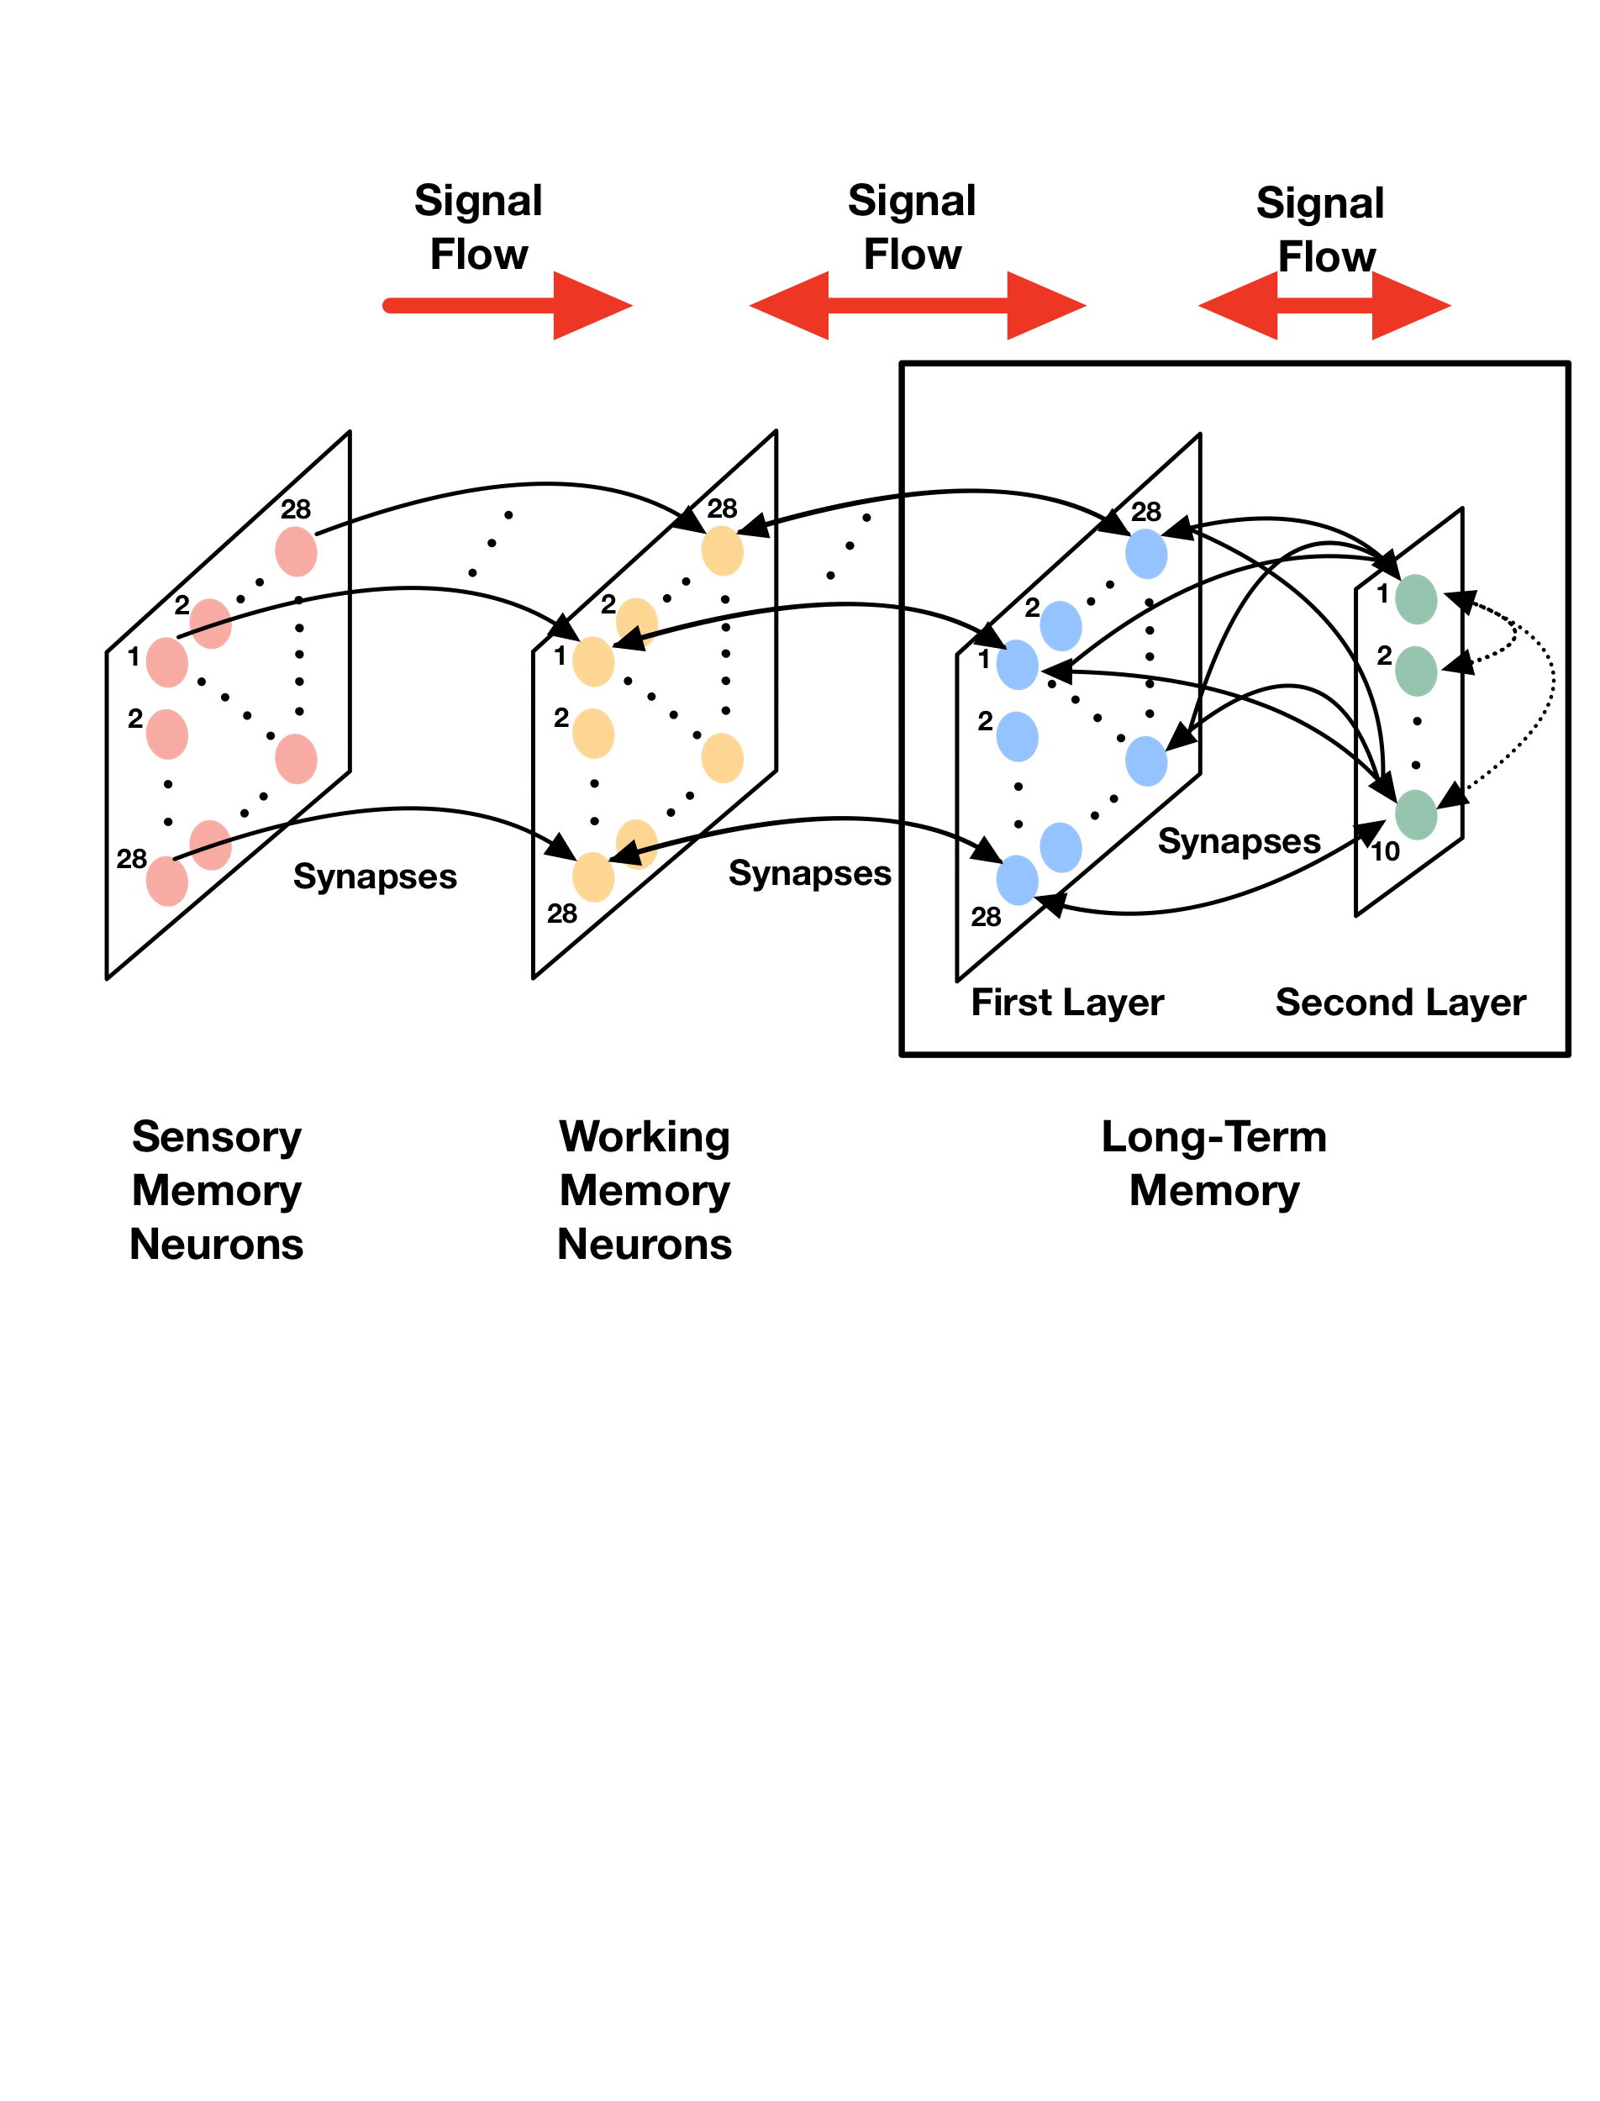


Complete Visual Memory System

Slide 18
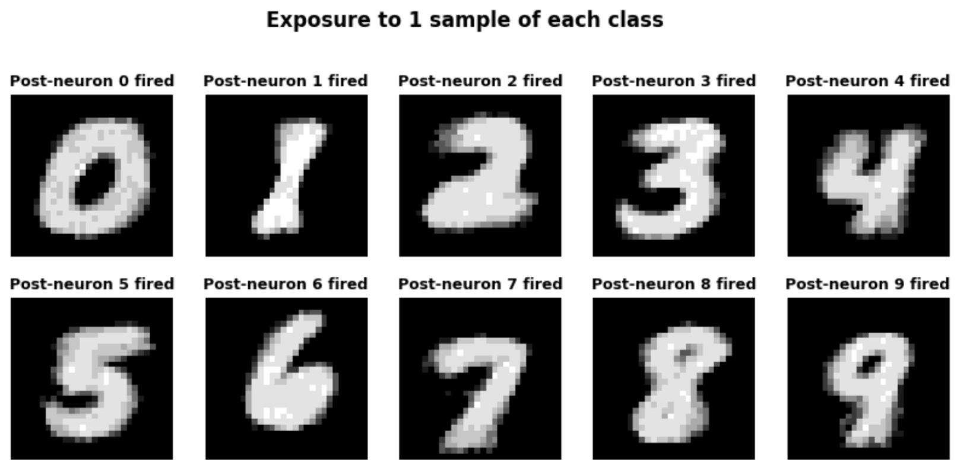
Recapitulation for Complete Visual Memory System: Unbiased Samples
Train accuracy: 70.5% (Trained on 100 unbiased samples per class)
Recapitulation (Excitations viewed in working memory):

Slide 19
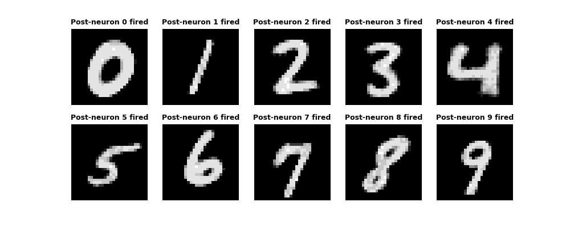
Recapitulation for Complete Visual Memory System: Biased Samples
A biased dataset was generated by choosing images from each class that look very similar,
according to Euclidean distance.
Train accuracy: 92.2% (Trained on 100 samples per class)
Recapitulation (Excitations viewed in working memory):

Slide 20
(a)
(b)

Slide 21
Retention - Schematic

Slide 22
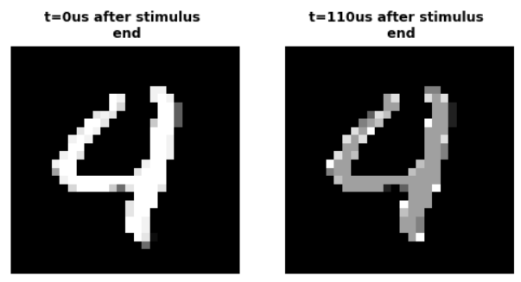
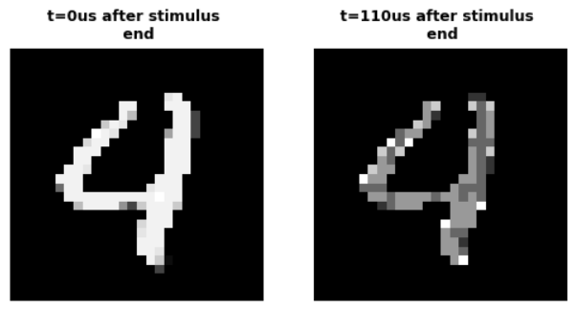
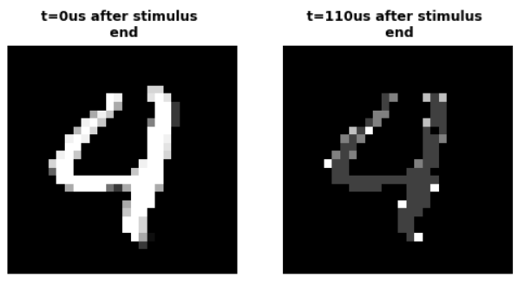
Retention
A single input is applied between t=0 and t=110us. Input is switched off after that. Excitations are viewed in working memory (Intervals: 0-110us and 110-220us), for different values of relay weights.
w = 3200
w = 800
w = 400

Slide 23
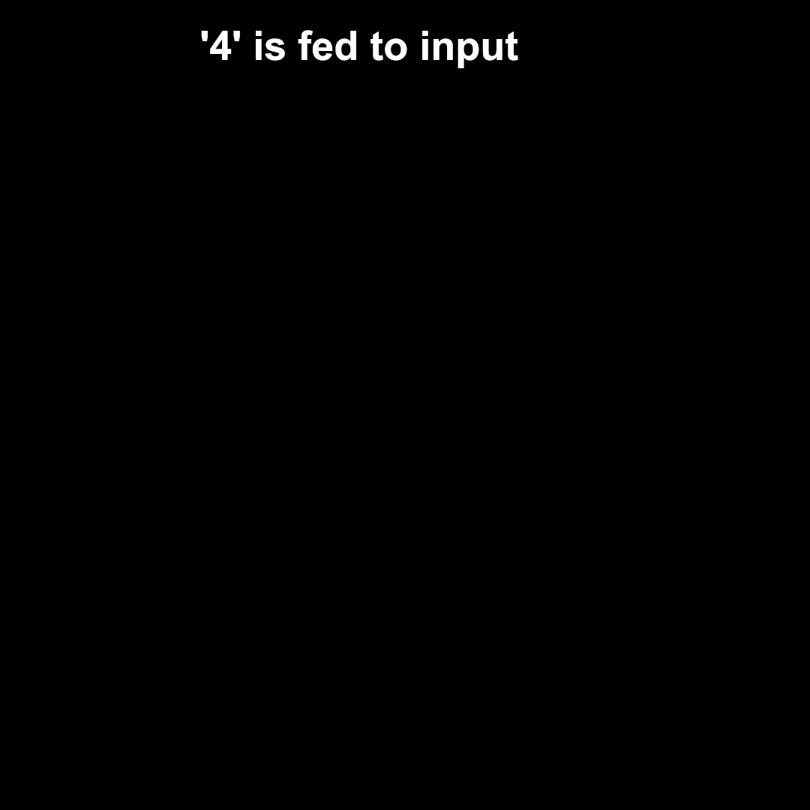

Retention
Apply a single input between t=0 and t=110us. Input is switched off after that. Excitations are viewed in working memory (2 intervals: 0-110us and 110-220us), for different values of relay weights. Note: The stimulus is applied till t = 11s of the video
The video is rescaled from us to s for viewing purposes (1us in reality is 1s in the video)
t = 0-110us
t = 110-220us
t = 220-330us
t = 330-440us

Slide 24
Recapitulation - Schematic

Slide 25
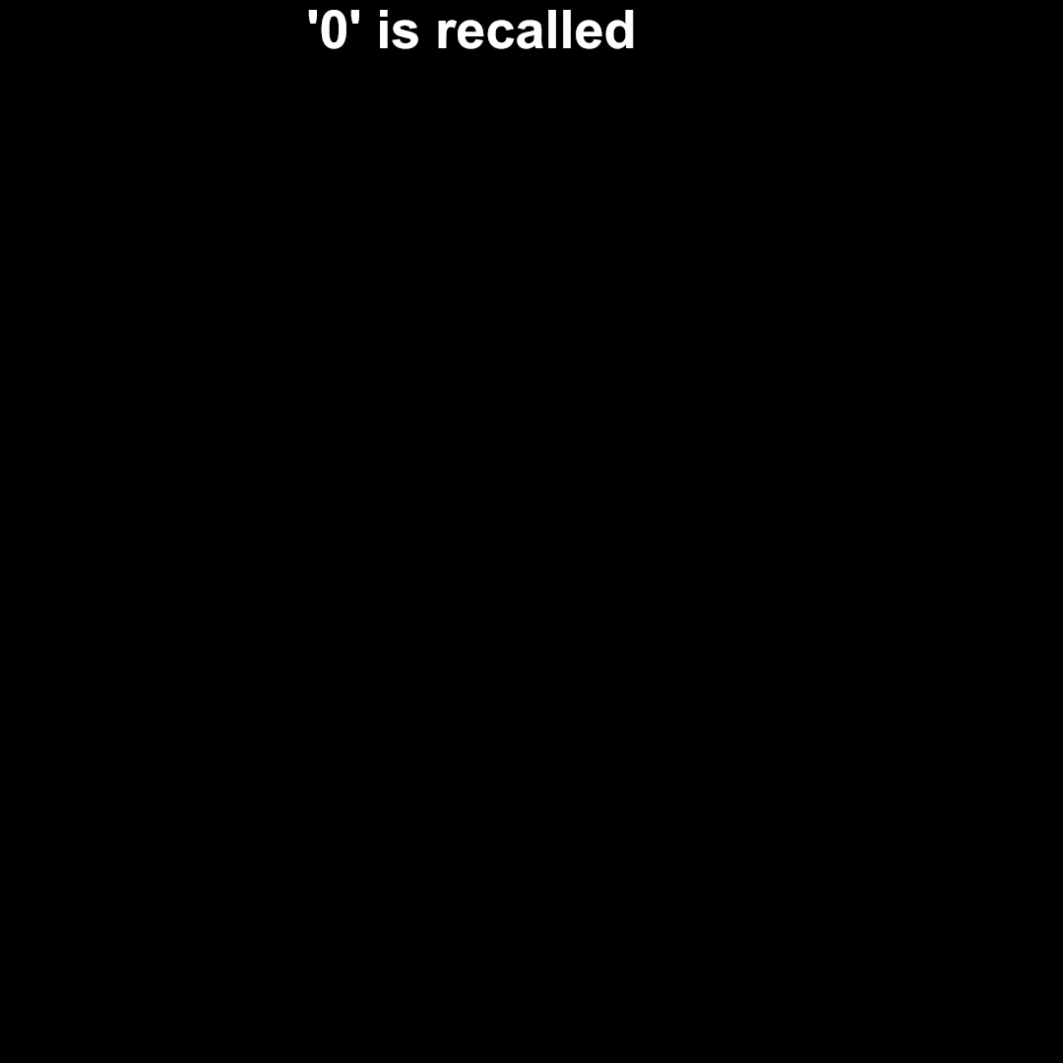
Complete Visual Memory System - Biased
Recapitulation - First Digit 0 then Digit 1 are recapitulated and the excitations are viewed in working memory:
The video is rescaled from us to s for viewing purposes (1us in reality is 1s in the video)
0-11s - digit 0 recapitulation
11-22s - no input
22-33s - digit 1 recapitulation
33-44s - no input

Slide 26
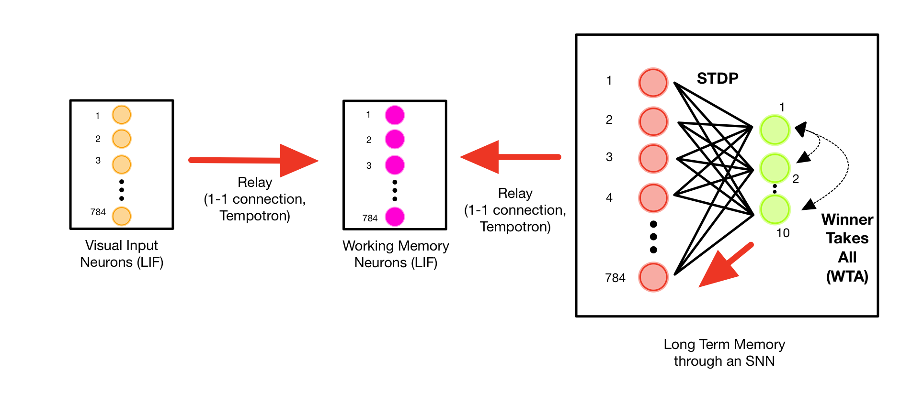
Recapitulation + Interfering Input - Schematic

Slide 27
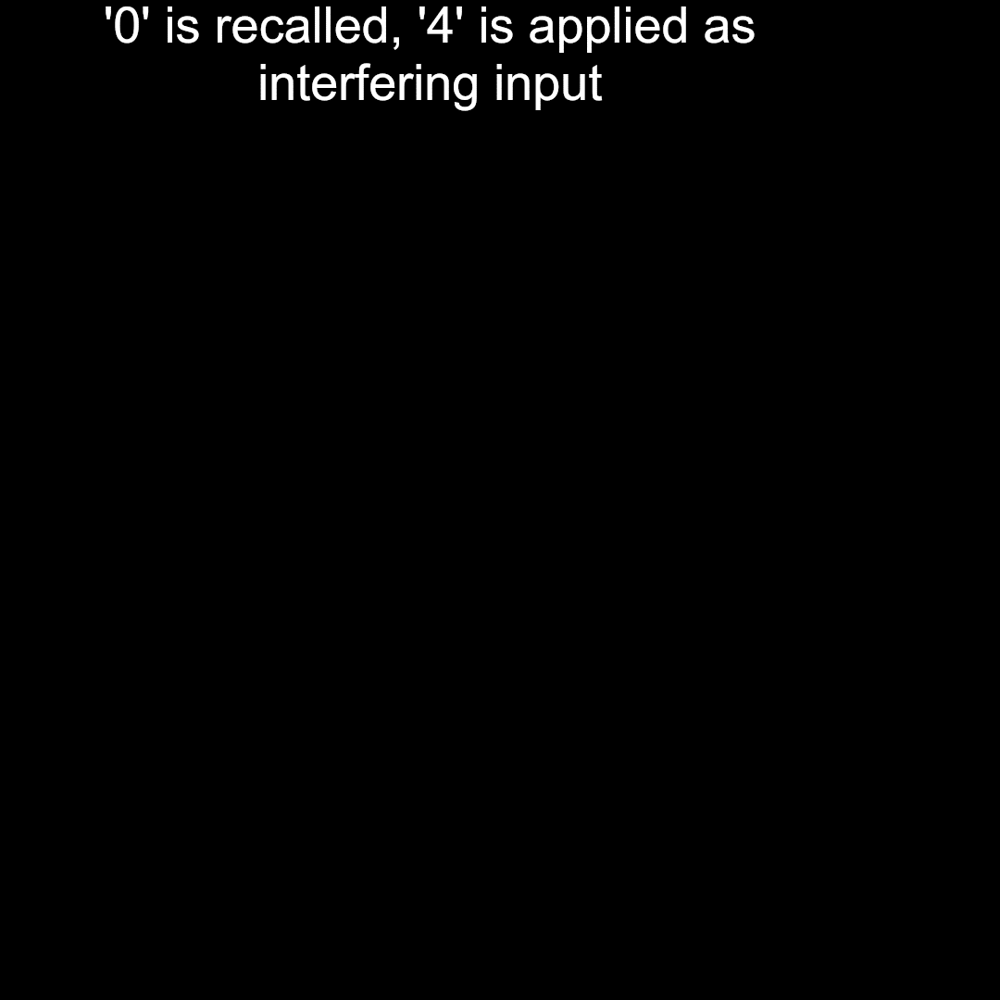

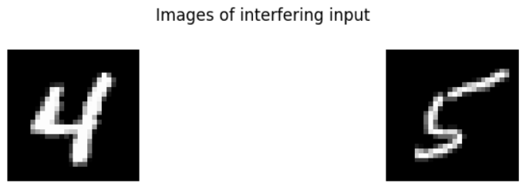
Complete Visual Memory System - Biased
Recapitulation + Different Input: (Excitations viewed in working memory)
t=0-11s of the video: Digit 0 is recalled, digit 4 is applied as interfering input.
t=11s-22s of the video: No input
t=22s-33s of the video: Digit 1 is recalled, digit 5 is applied as interfering input
t=33s-55s of the video: No input
t = 0-110us
t = 110-220us
t = 220-330us
t = 330-440us

Slide 28

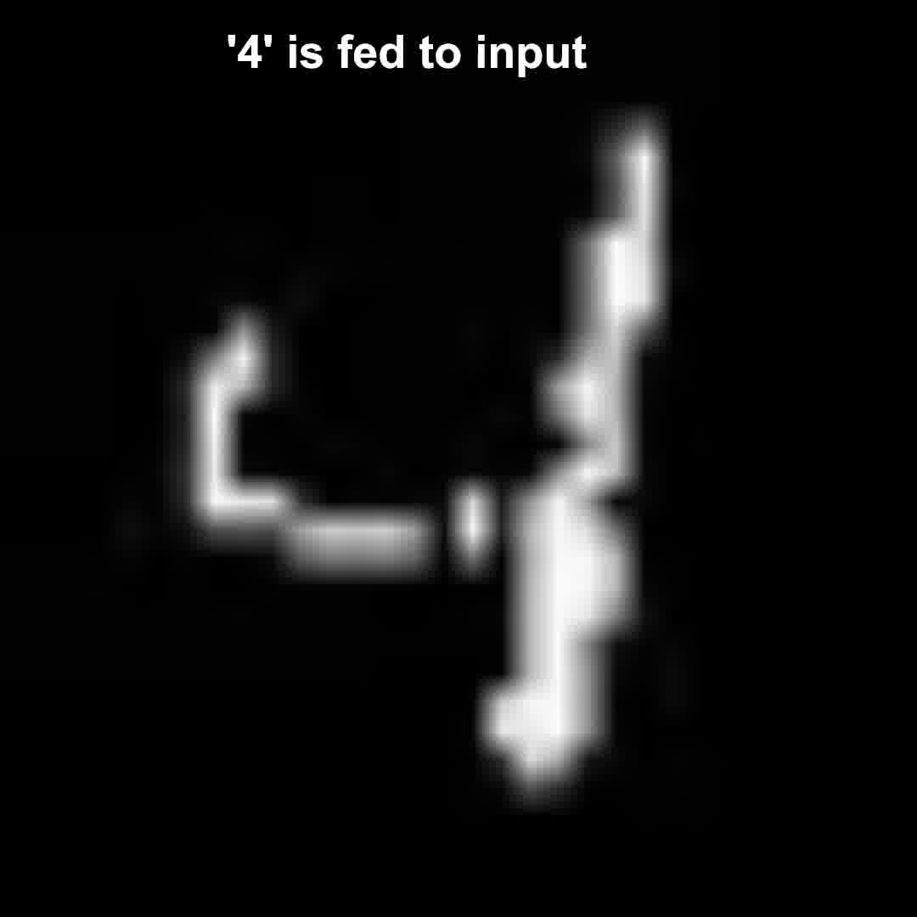
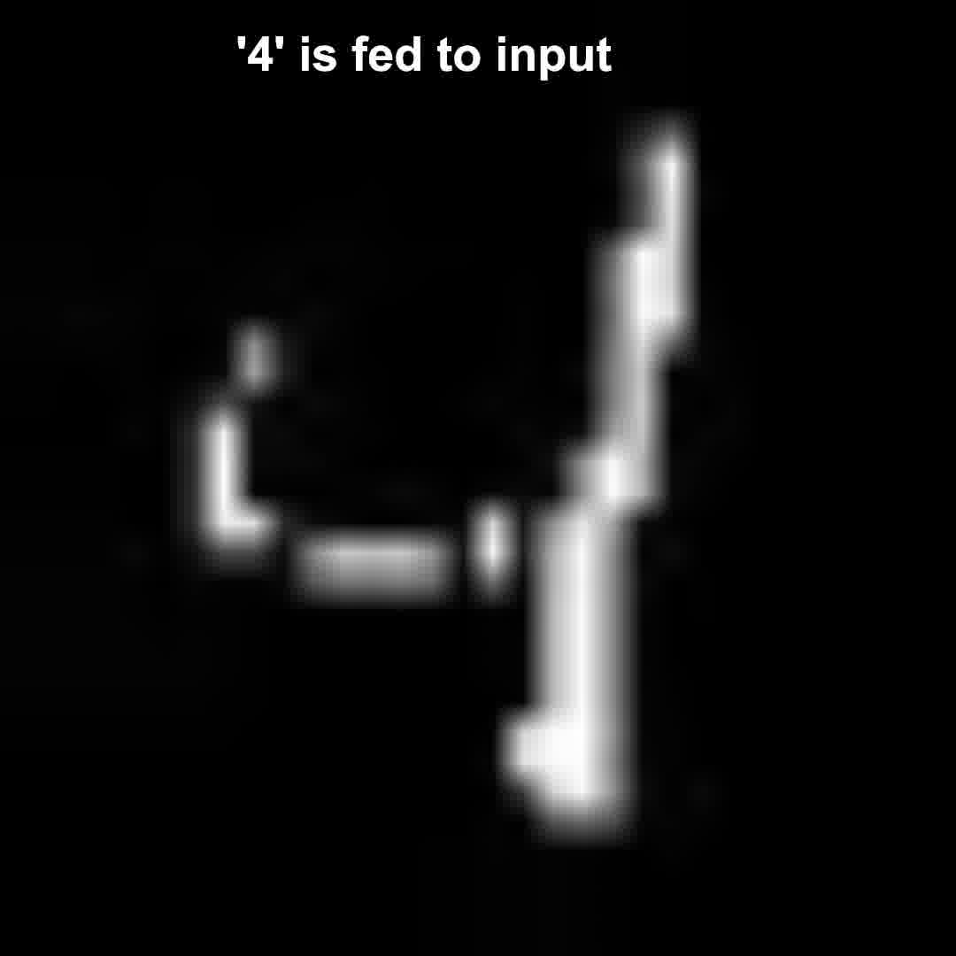
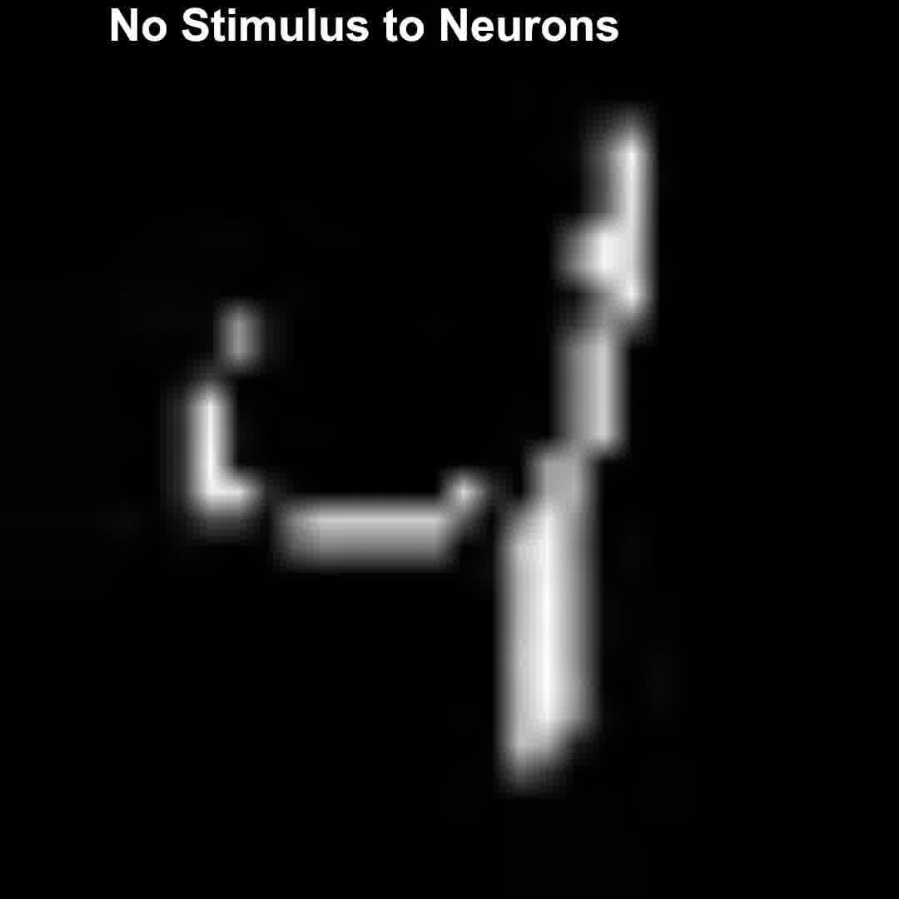
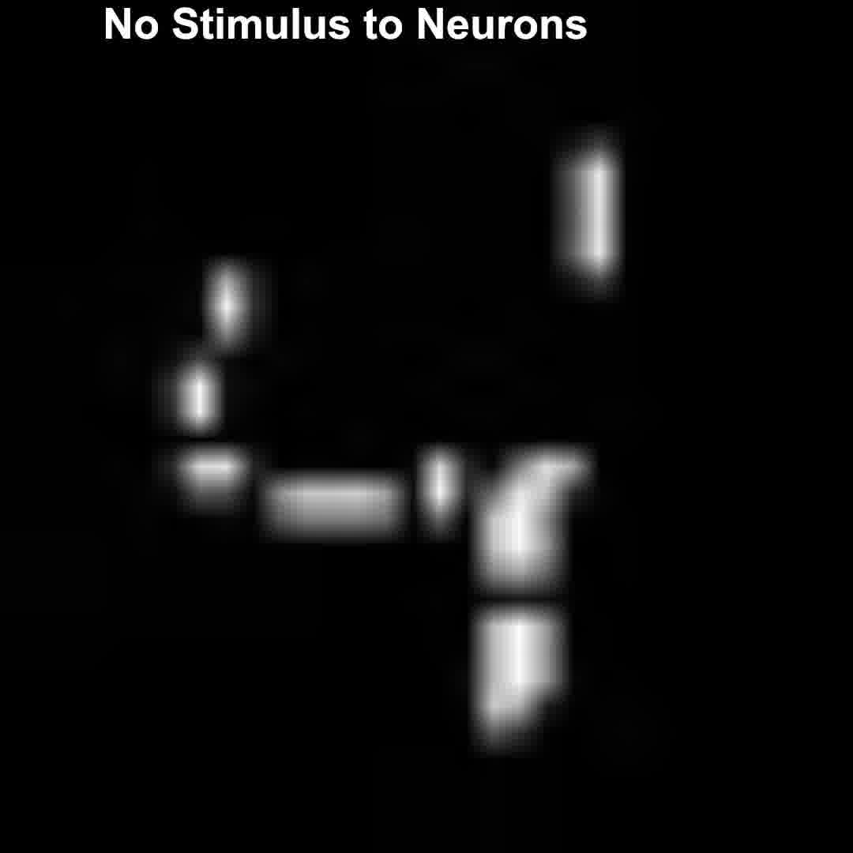
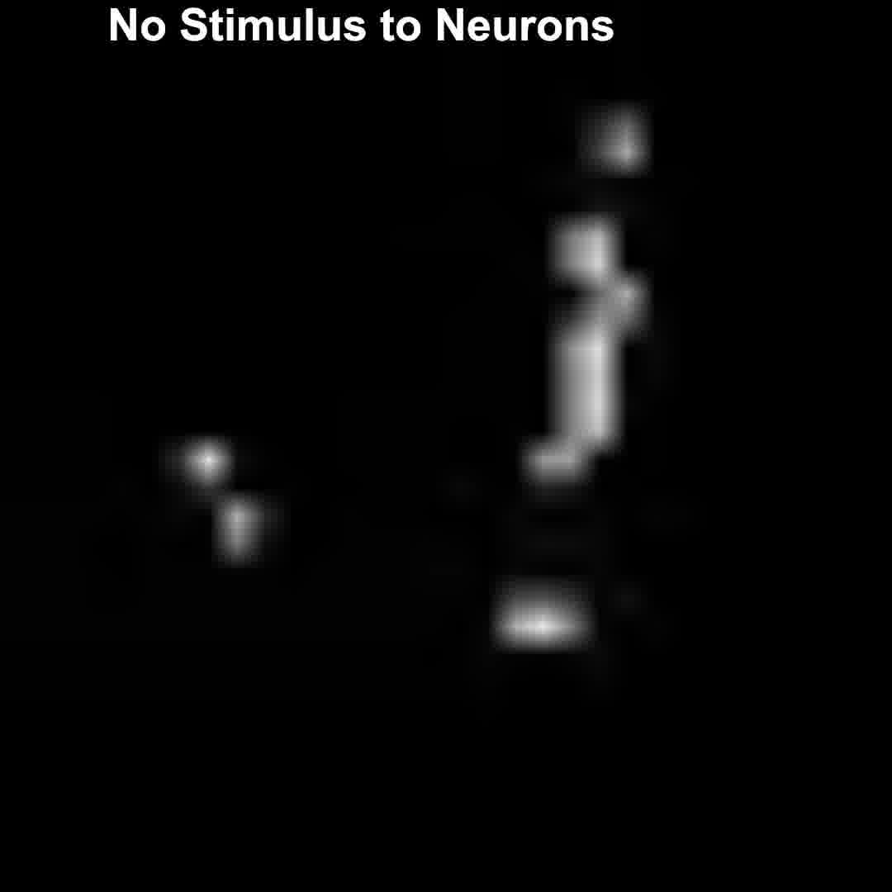

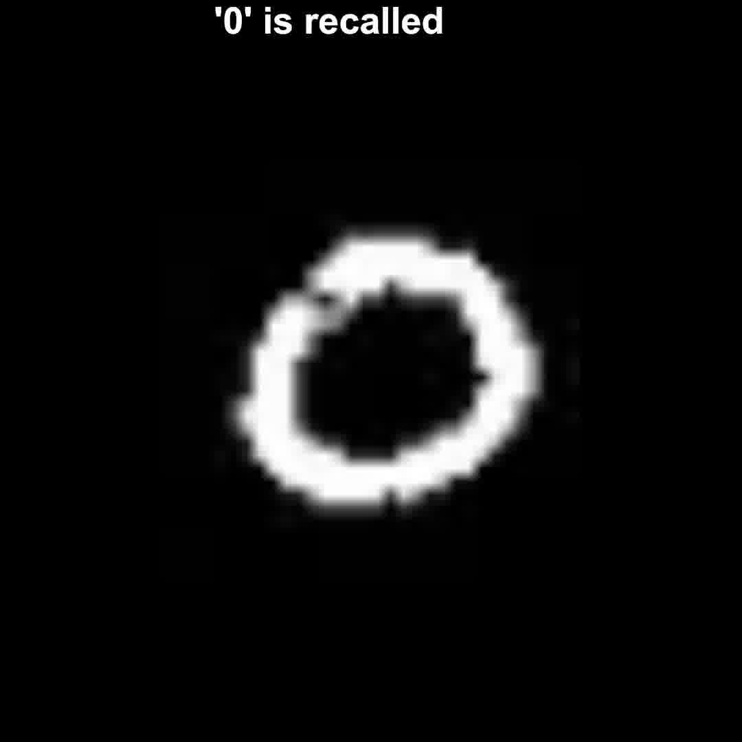
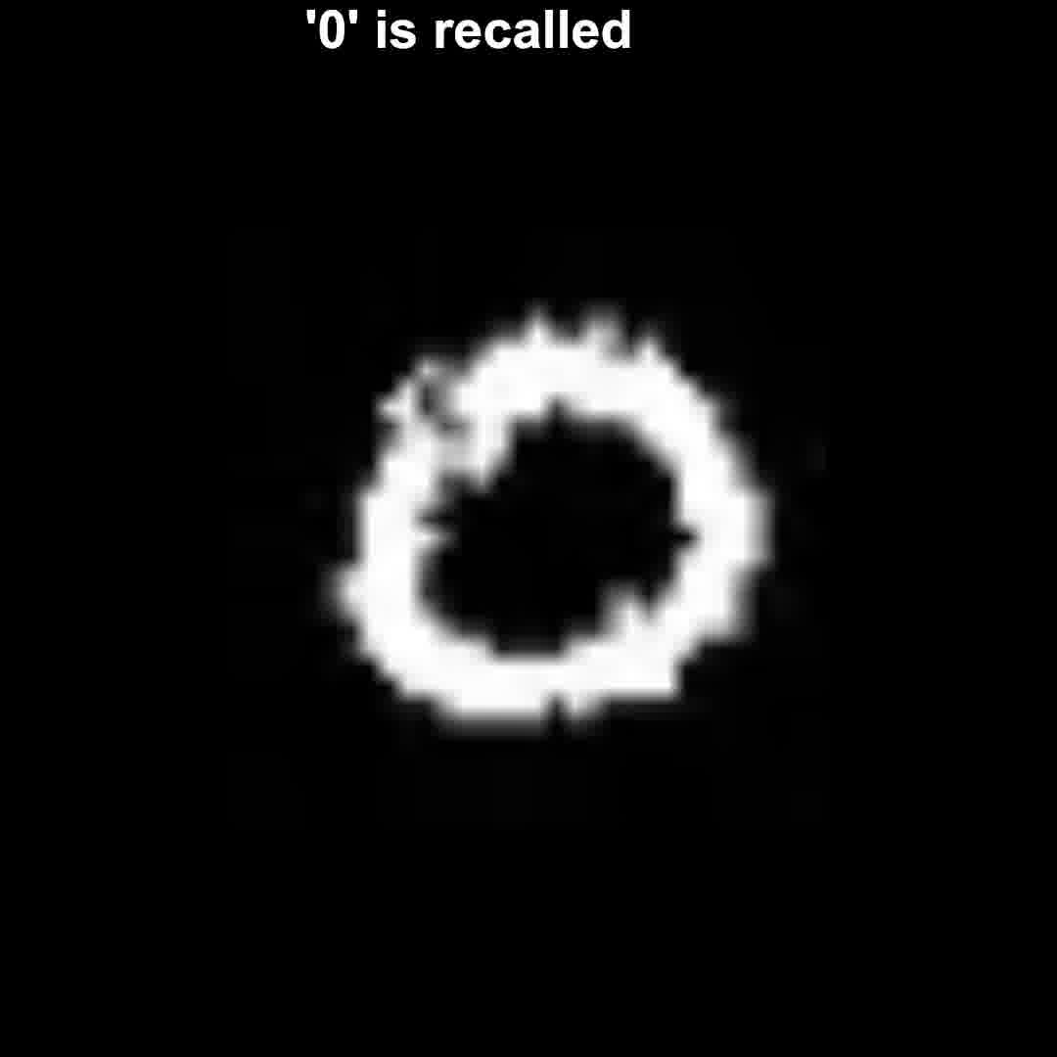
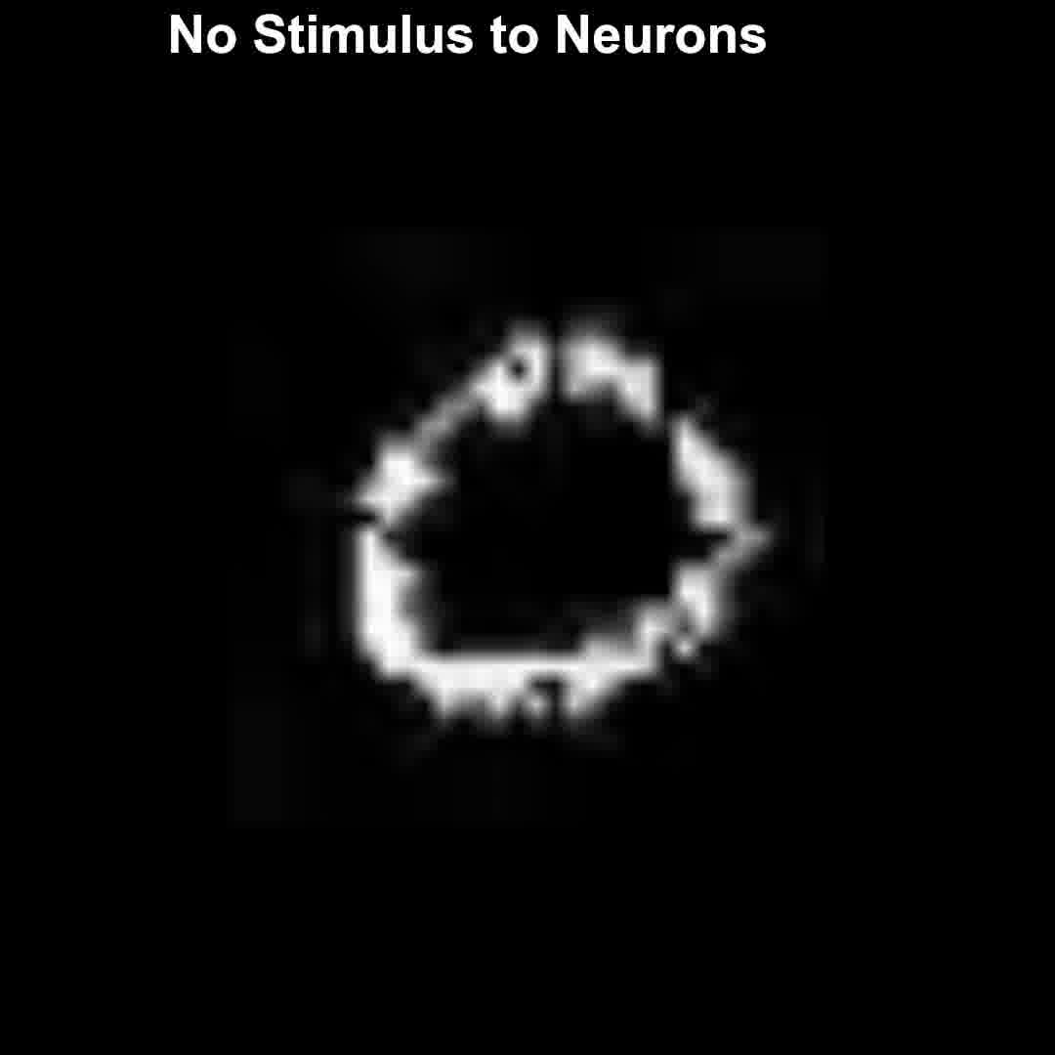
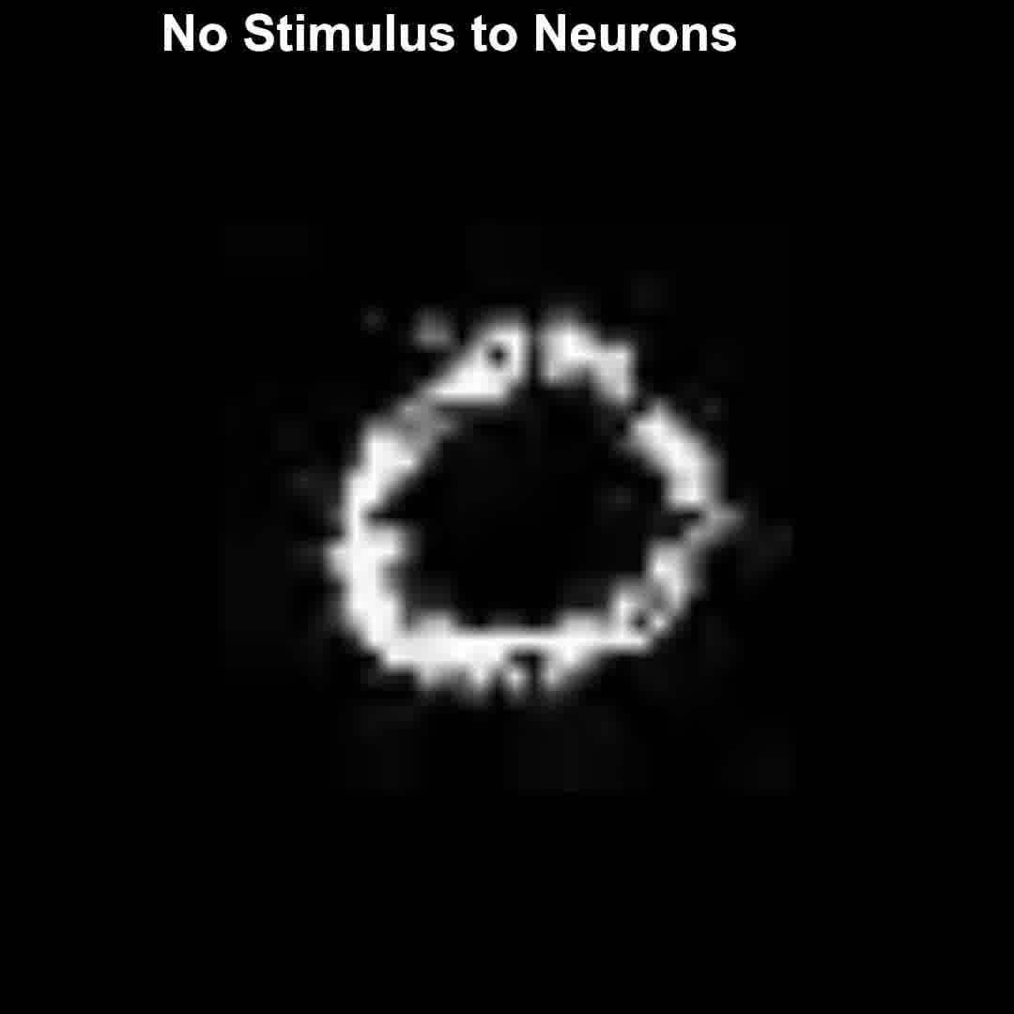
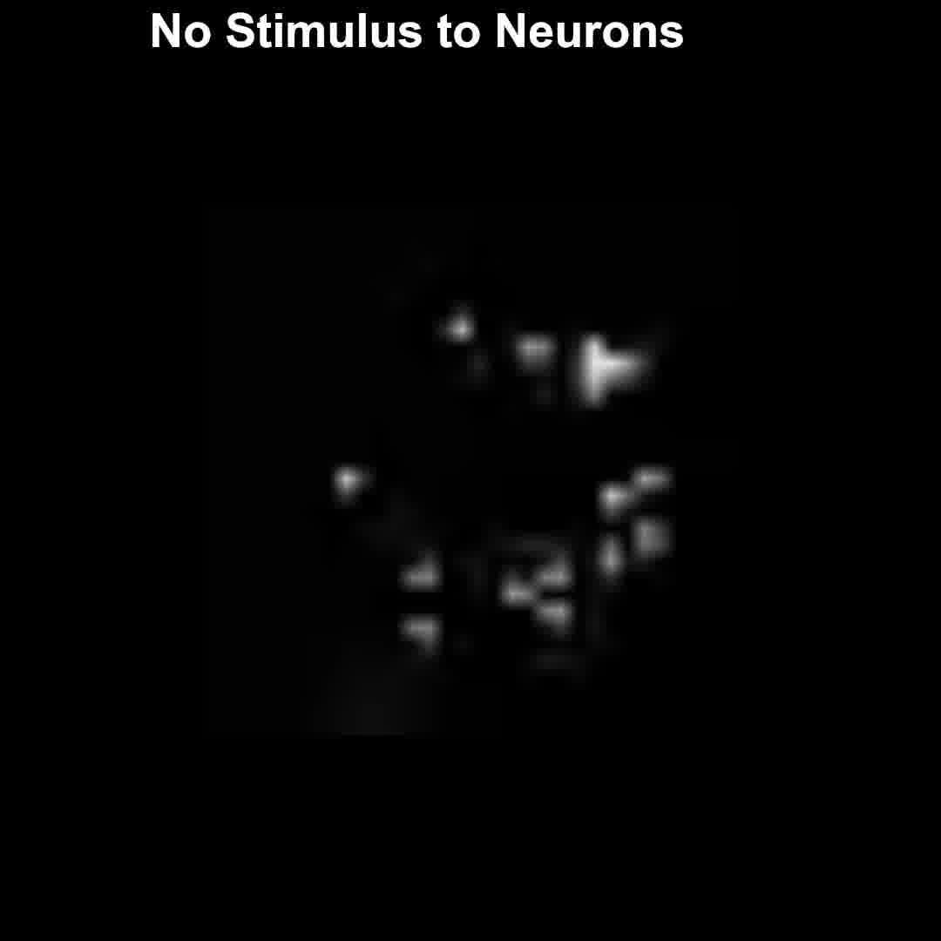

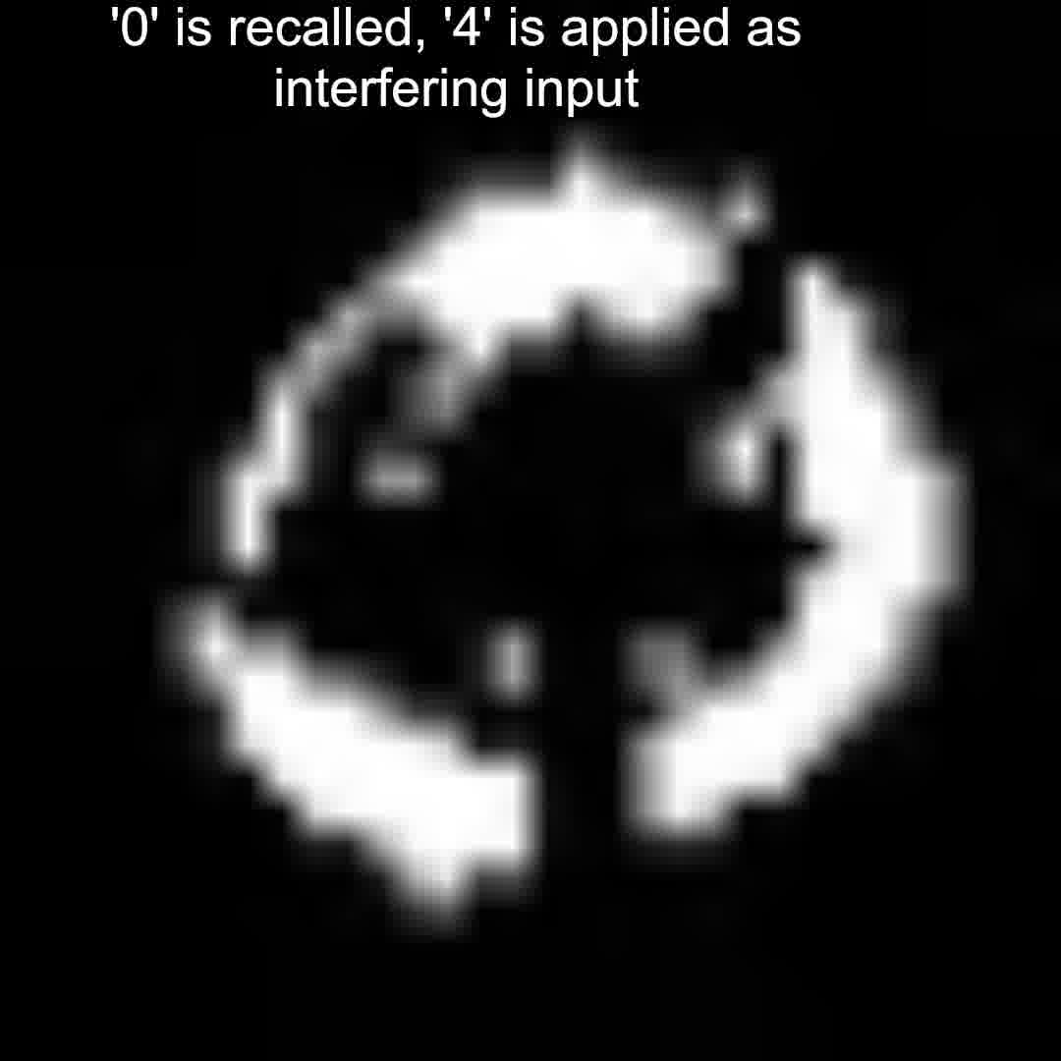
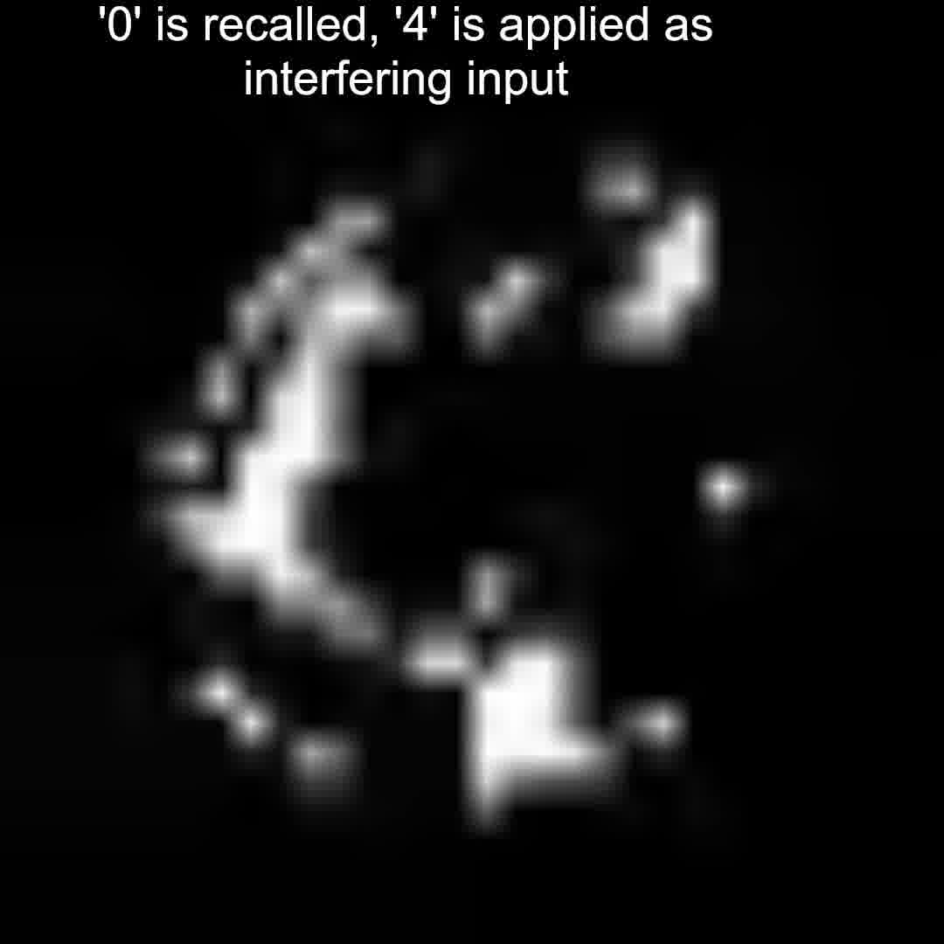
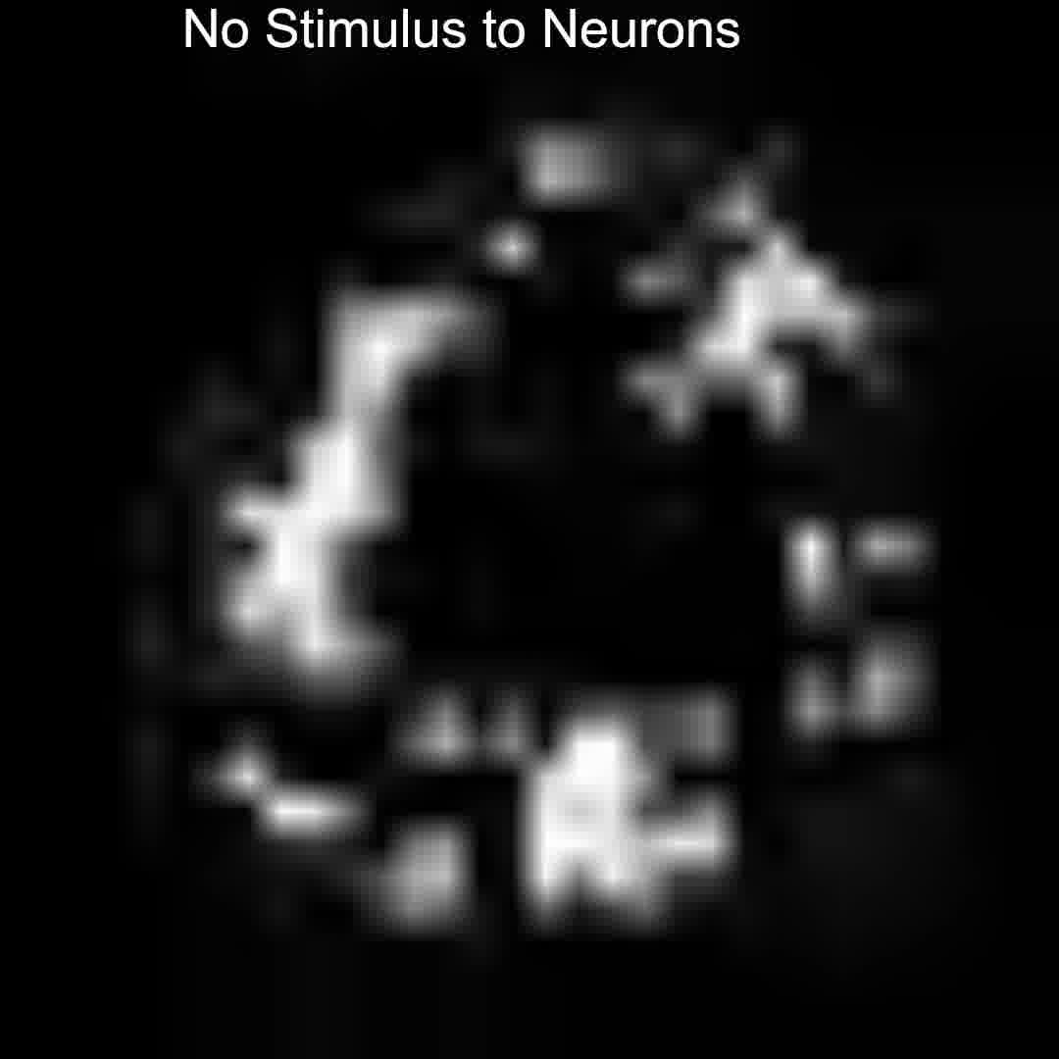
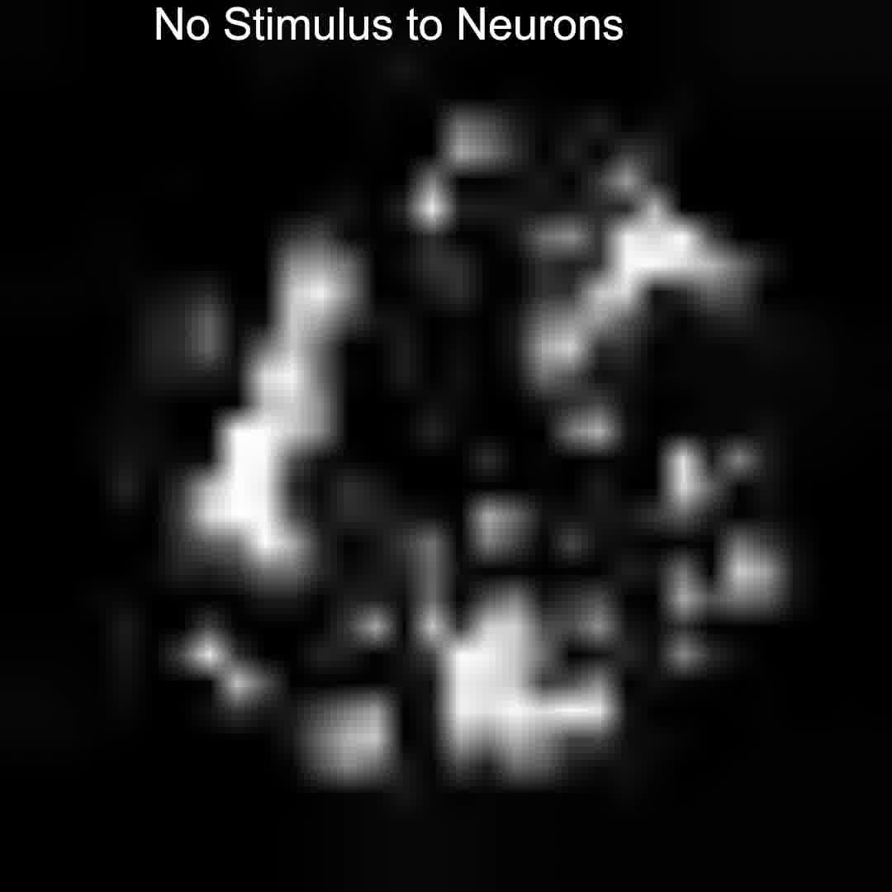
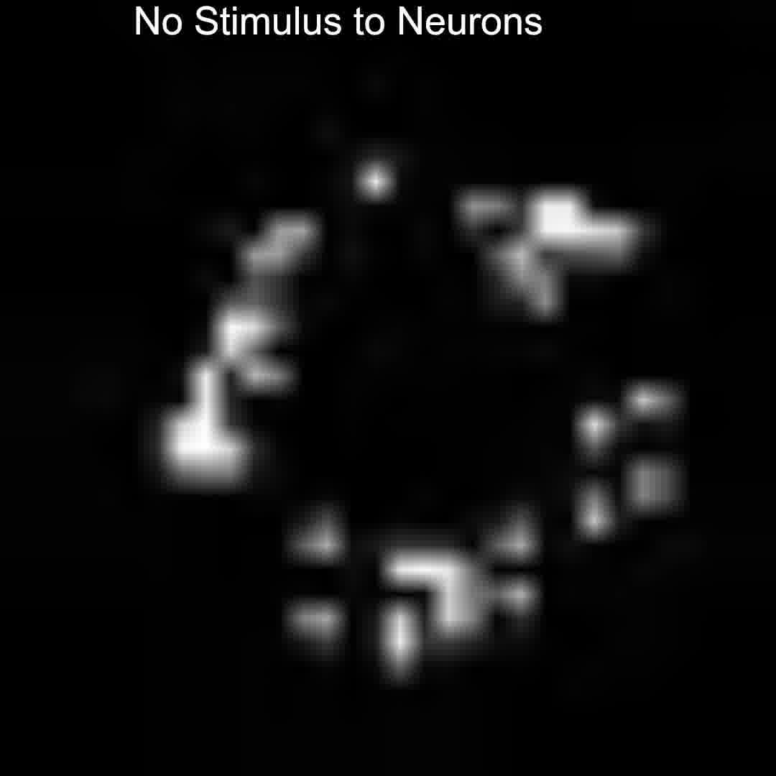
(a)
t = 0 – 1 μs
t = 49 – 50 μs
t = 99 – 100 μs
t = 116 – 117 μs
t = 122 – 123μs
t = 124 – 125 μs
(b)
t = 0 – 1 μs
t = 34 – 35 μs
t = 99 – 100 μs
t = 114 – 115 μs
t = 124 – 125 μs
t = 130 – 131 μs
(c)
t = 0 – 1 μs
t = 39 – 40 μs
t = 40 – 41 μs
t = 115 – 116 μs
t = 120 – 121 μs
t = 130 – 131 μs

